Slide 1
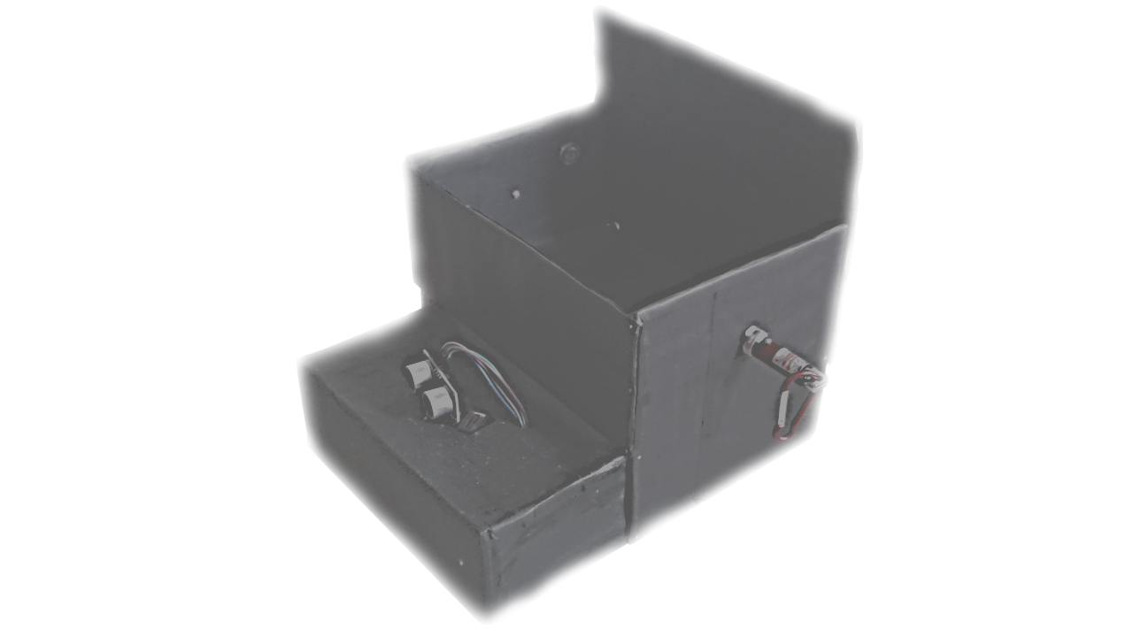
The Arduino Radar
With
Lazer Light Security System

Slide 2
Abstract :-
A rangefinder is a device that measures the distance from the target to the observer , for the purpose of surveying , determining focus in photography , or accurately aiming a weapon .
In this technical project , we make a simple radar using the ultrasonic sensor and a simple lazer alarm circuit , this radar works by measuring a range from 3cm to 40cm as non-contact distance with angle range between 15 and 165 angles .
The moment of the sensor is controlled by using a small servo motor .
Information received from the sensor will be used by “Processing Development Environment” software to illustrate the results on a pc screen .
-: 01 :-

Slide 3
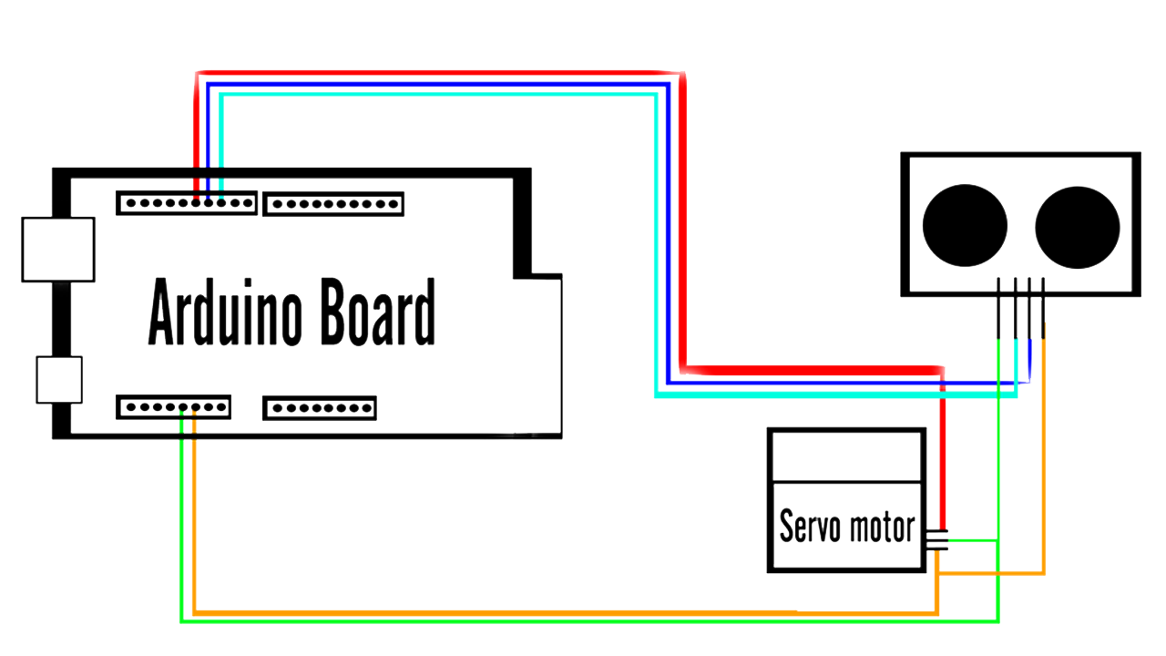
Wire Connections Of The Arduino Radar
-: 02 :-

Slide 4
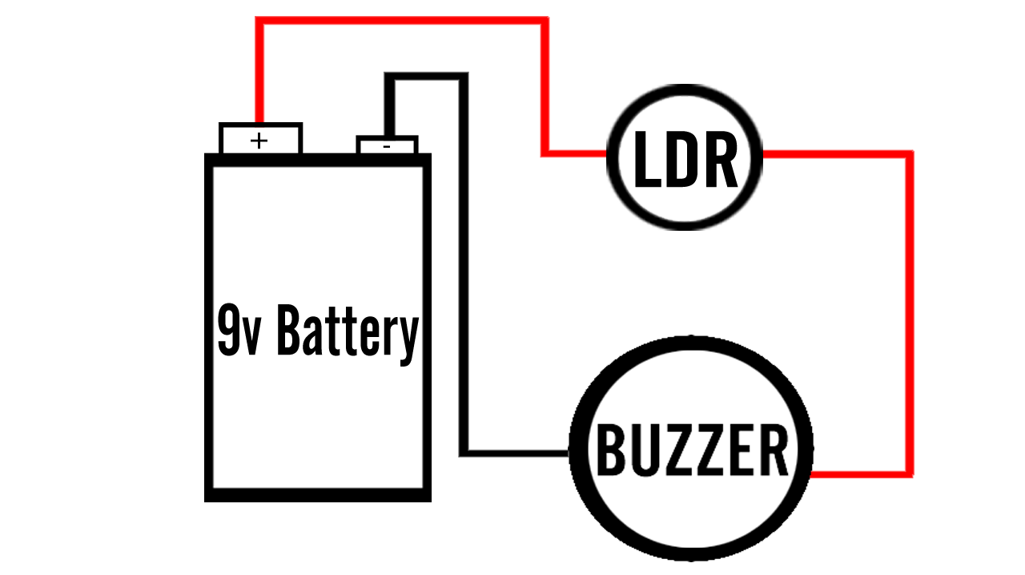
Wire Connections Of The Lazer Light Security System
-: 03 :-

Slide 5
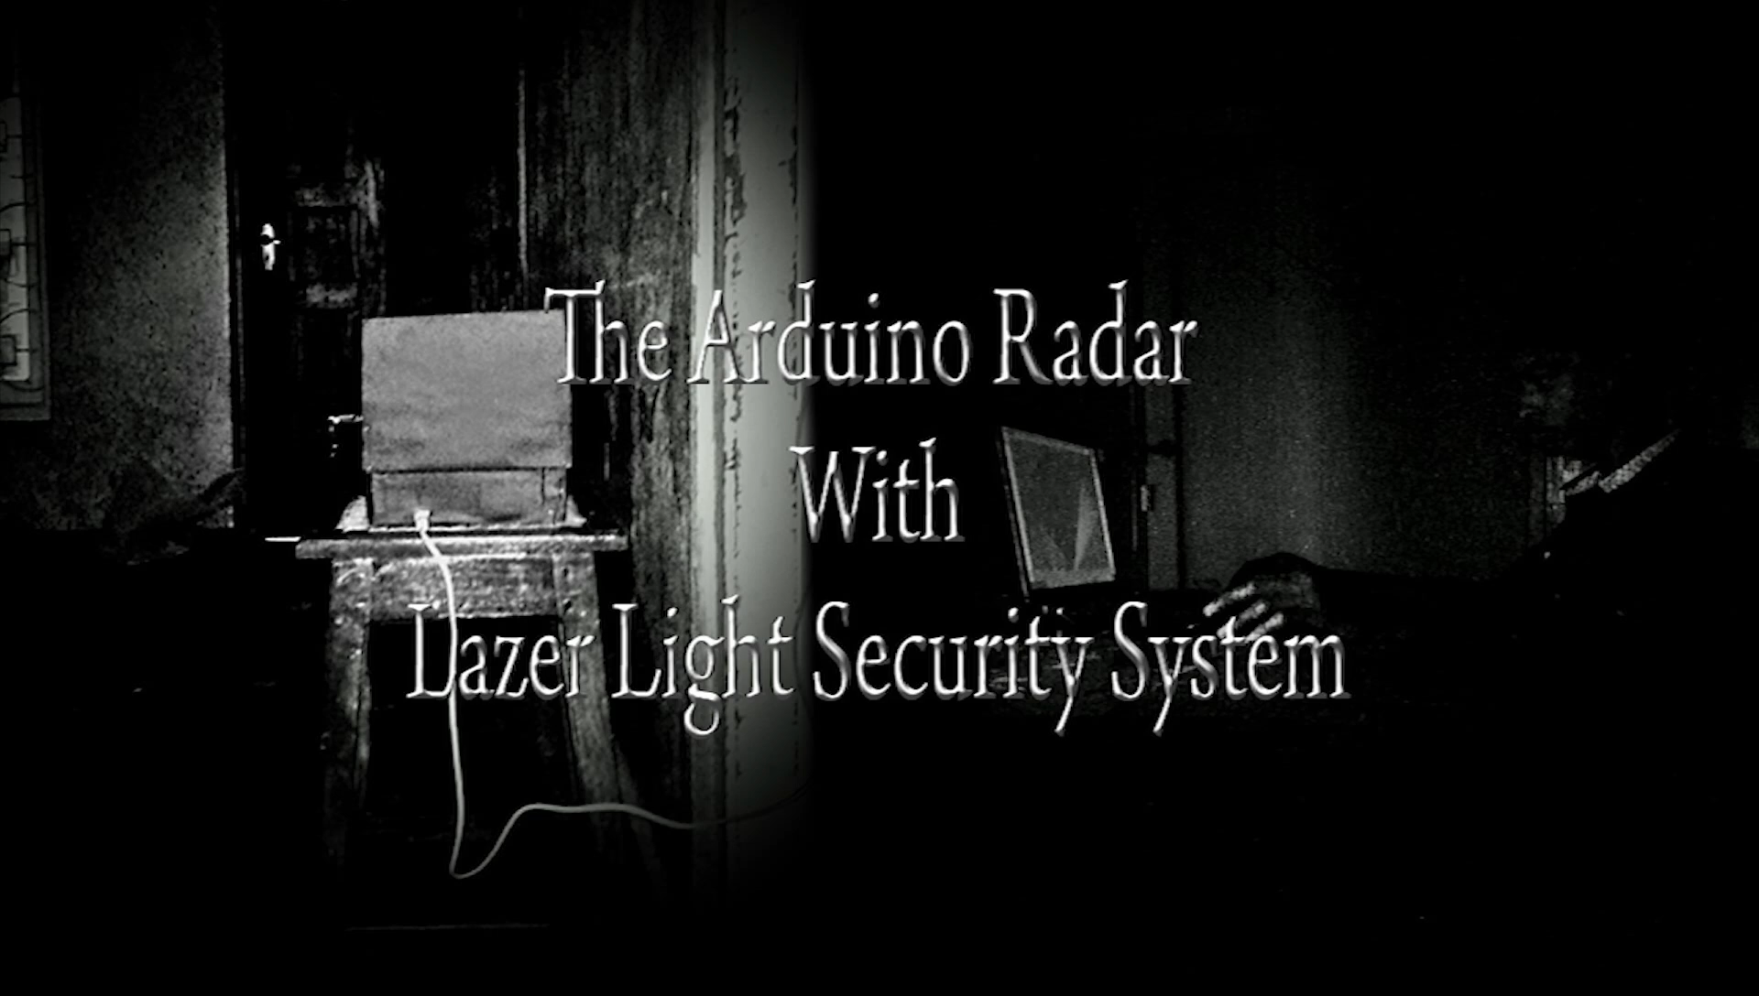

Slide 6
Usages And Benefits OF This Project
Simply the Radars are using in the ships and aero planes . In the ships and aero planes ,they are use this radar to find any dangerous weapons going to attack or , if any barriers going to crash the ships the radar will give sounds or anything .
But this project is helps us secure any things . In whatever places and whatever things can be secured .
We don’t want to give money to a security and take him to work . We can get/made this project with simple cost and get benefits easily .
And this can be use in bank , military weapon store and secure the jail also .
This project is very easy to made and easy to maintain
-: 04 :-

Slide 7
Thank You…

